Slide 1

External Project Presentation of Computer Networking(CSE 3034) on Scientific Calculator using Client-Server Architecture. (Socket Programming)
Presented by
Dharmesh Raj– 2141018036
Utsav Raj – 2141018035
Akash Pradhan– 2141016398
Saket Ranjan- 2141018057
Supervisor
Prof. Sebamai Parija
Department of Computer Science and Engineering
Institute of Technical Education & Research (FET)
Siksha ‘O’ Anusandhan Deemed to be University, Bhubaneswar
Jan, 2024

Slide 2
Contents
Introduction
Problem statement
Methodology
Implementation
Result and Interpretation
Conclusion

Slide 3
Introduction
Objective:
Develop a scientific calculator using client-server architecture with a focus on socket programming.
Key Components:
Client: User interface for input and results display.
Server: Backend processing mathematical operations.
Socket Programming: Communication protocol facilitating interaction between client and server.

Slide 4
Problem Statement
Developing a scientific calculator that efficiently performs complex computations through a client-server architecture, employing socket programming for seamless communication, to enhance collaborative and distributed computing experiences.

Slide 5
Methodology
Client-Server Design:
Establish a client-server architecture where the client provides input, and the server processes mathematical operations.
Socket Programming:
Implement socket programming for communication between the client and server, ensuring efficient data exchange.
Mathematical Operations Handling:
Design algorithms on the server to handle complex mathematical operations requested by the client.
Error Handling:
Implement robust error-handling mechanisms to enhance the reliability of the calculator.

Slide 6
Implementation
Client Side:
Develop a user-friendly interface for input and result display.
Server Side:
Implement backend logic to process mathematical operations and respond to client requests.
Socket Integration:
Incorporate socket programming for seamless communication between the client and server.
Concurrency Handling:
Address concurrency issues to support multiple client connections concurrently.
User Input Validation:
Validate user input on the client side to enhance security and prevent erroneous calculations.

Slide 7
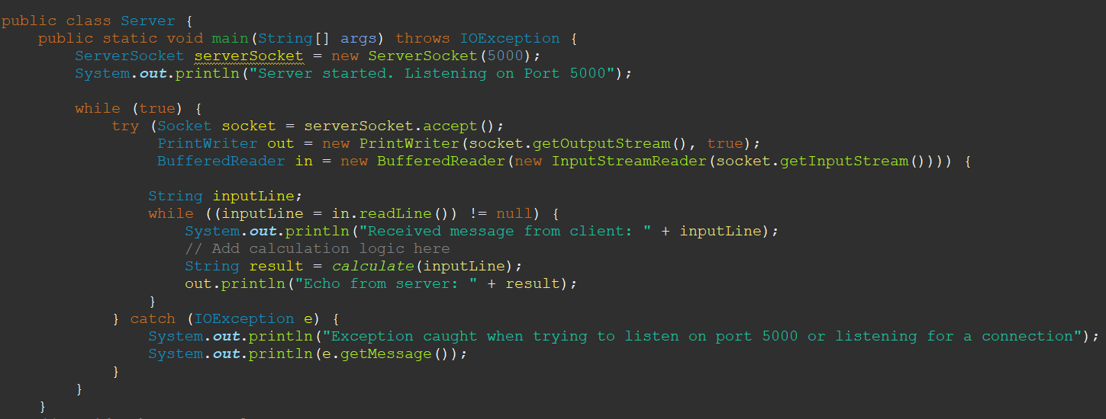

Implementation
This is Server side program snippet.
This is Client side code snippet.

Slide 8
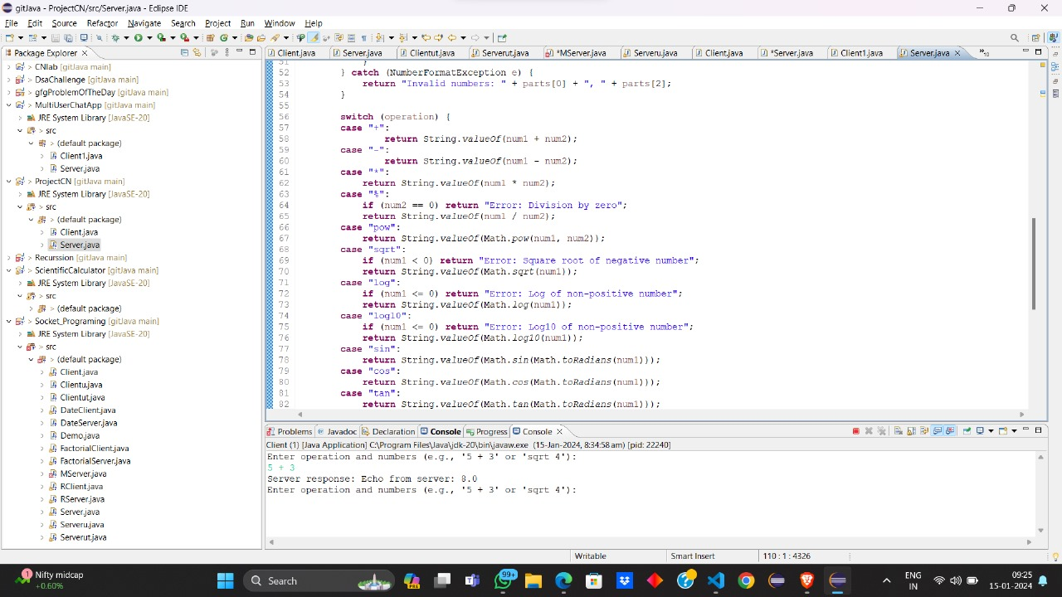

Slide 9
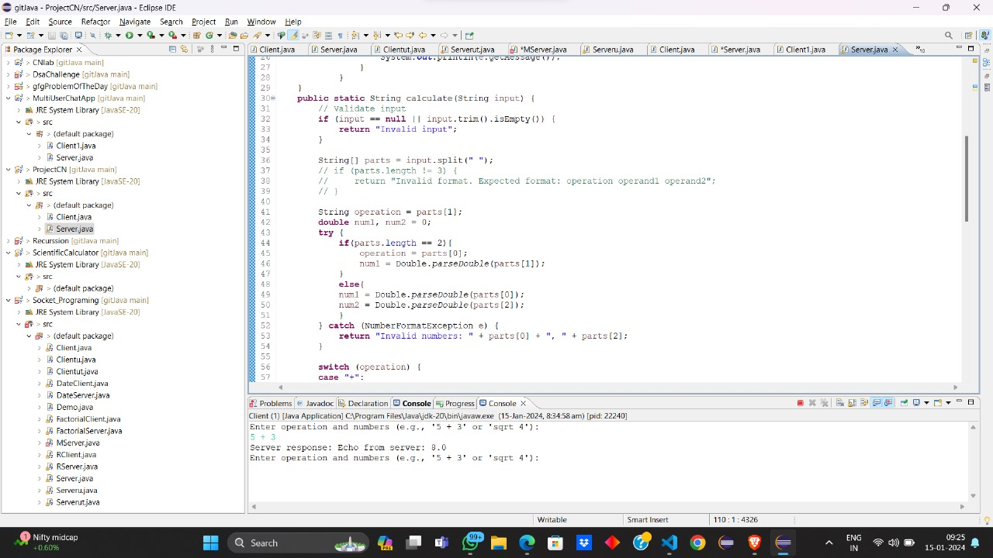

Slide 10
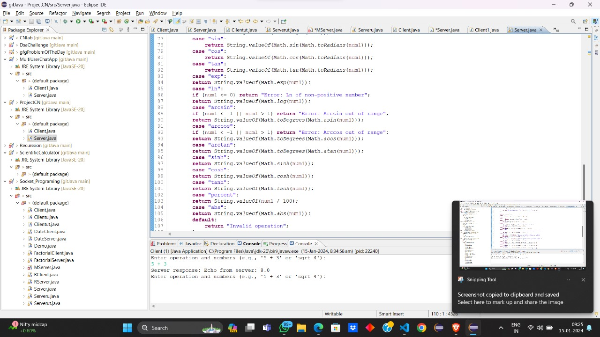

Slide 11
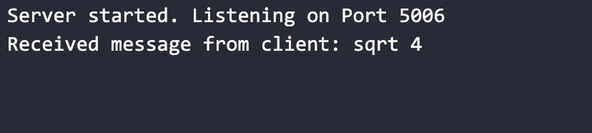
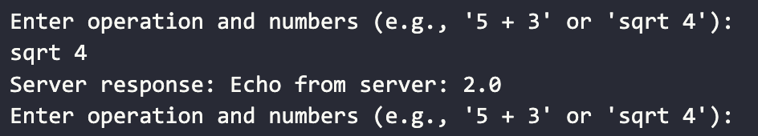
Result and Interpretation
Output:
Server:
Client:

Slide 12
Conclusion
In conclusion, the successful implementation of a scientific calculator employing a client-server architecture in Java showcases the effective use of key libraries. Leveraging java.io and java.net facilitated seamless communication, while java.util supported concurrent handling for improved efficiency. The incorporation of these libraries, coupled with algorithms for mathematical operations, results in a reliable and responsive application. This project underscores Java's versatility in building networked applications, providing valuable insights into the potential of distributed computing.

Slide 13
References
[1]Tannenbaum, A. S. (2003). "Computer Networks." Pearson India.
[2]Harold, E. R. (2005). "Java Network Programming." O’Reilly (Shroff Publishers).
[3]Oracle Corporation. (2021). "Java™ Platform, Standard Edition 11 Documentation." [Online]. Available: https://docs.oracle.com/en/java/javase/11/
[4]Stevens, W. R., Fenner, B., & Rudoff, A. M. (2003). "UNIX Network Programming, Volume 1: The Sockets Networking API." Addison-Wesley.

Slide 14


